Slide 1
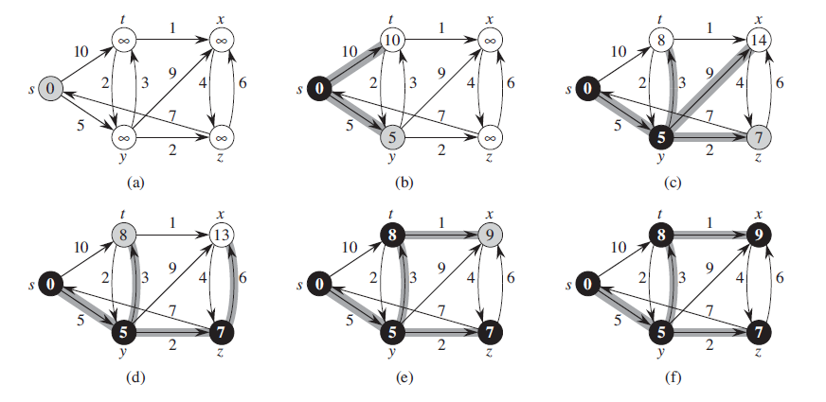
Dijkstra’s Algorithm
Find The Shortest Path
Michael Uftring
Indiana University
I-590 Data Visualization
Fall, 2017
http://www.codebytes.in/2014/08/dijkstras-algorithm-implementation-in.html

Slide 2
Introduction
What is this project about?
What will be presented?

Slide 3
Objectives
Purpose
To explore and visualize Dijkstra’s Shortest Path algorithm
Motivation
Mid-term was a data analysis project
I wanted to undertake a dev-type project
Dust off my memory of something I learned in undergrad
Work on something in an area that I have a lot of interest
graph theory, networks, complex systems

Slide 4
Dijkstra’s Algorithm
What is it?
An algorithm for finding the shortest path between nodes in a graph
https://en.wikipedia.org/wiki/Dijkstra%27s_algorithm

Slide 5
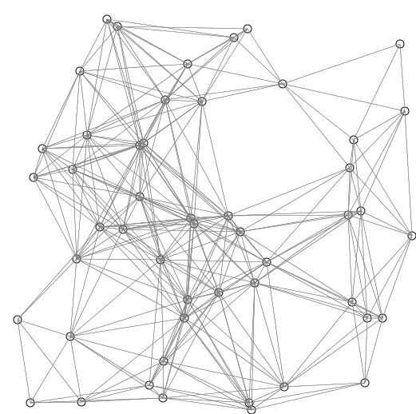
Dijkstra’s Algorithm
How does it work?
picks the unvisited node with the lowest distance,
calculates the distance through it to each unvisited neighbor
updates the neighbor's distance if smaller
https://commons.wikimedia.org/w/index.php?curid=54537901

Slide 6
Dijkstra’s Algorithm
Why is this interesting and important?

Slide 7
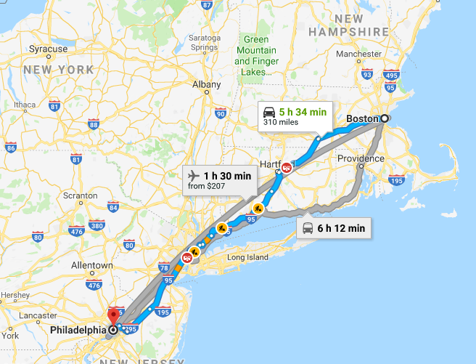
Dijkstra’s Algorithm
Where is this (or related algorithms) used?
Routing computer network traffic
Transportation networks
e.g., roads, trains, airplanes

Slide 8
Dijkstra’s Algorithm
Maybe a more accurate description would be: finding the most optimal path
Consider a network with more than one path from the source to the destination
“short” implies distance (perhaps the fewest hops?)
The path with least cost may be longer in terms of hops
The sum total of the edge weights of each hop is less than that of perhaps “shorter” paths

Slide 9
Related Work
Search the Internet for: visualizing dijkstra's algorithm
Google reports “About 86,800 results”
Some are visual explanations of Dijkstra’s algorithm
Some serve specific needs (i.e., gaming)
Just 3 will be showcased here (in the interest of time, and doing justice to the implementers)

Slide 10
David Galles, University of San Francisco
Description
https://www.cs.usfca.edu/~galles/visualization/Dijkstra.html

Slide 11
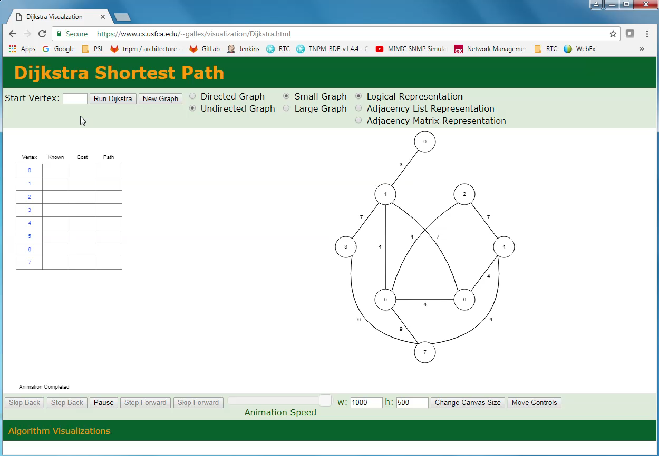
Demo

Slide 12
Assessment
Likes
Dislikes
Blah, blah
Blah, blah

Slide 13
Lisa Velden, Technischen Universität München
Description
https://www-m9.ma.tum.de/graph-algorithms/spp-dijkstra/index_en.html

Slide 14
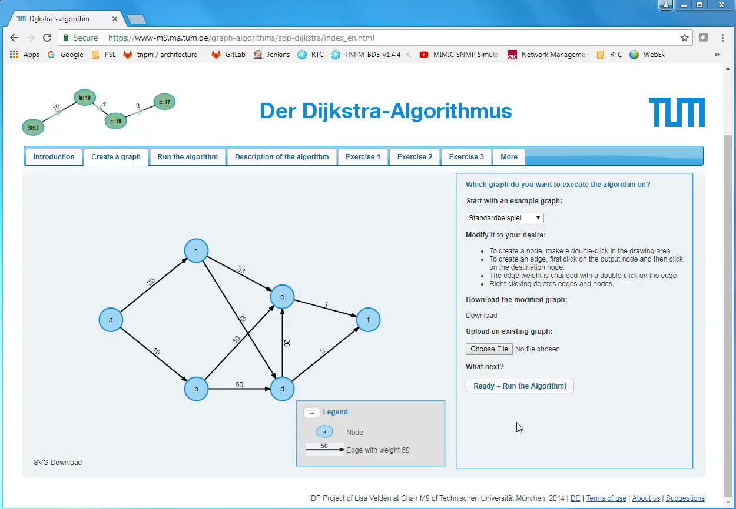
Demo

Slide 15
Assessment
Likes
Dislikes

Slide 16
GraphOnline.ru
Description
http://graphonline.ru/en/

Slide 17
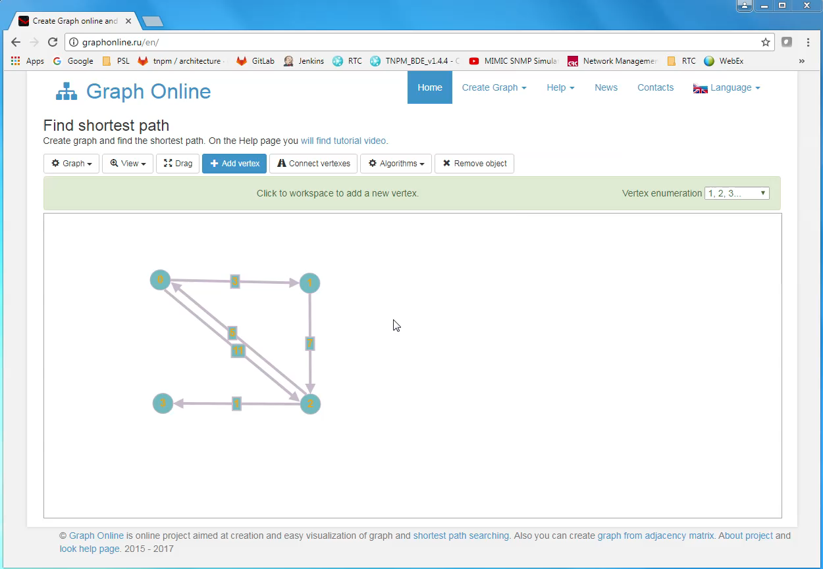
Demo

Slide 18
Assessment
Likes
Dislikes

Slide 19
Honorable Mentions
Matthew Wigginton Conway
http://projects.indicatrix.org/dijkstra.js/
VisuAlgo.net
https://visualgo.net/en/sssp
Xueqiao (Joe) Xu, Google
https://qiao.github.io/PathFinding.js/visual/

Slide 20
Summary
The good
The bad

Slide 21
Project Details
Now that we know about Dijkstra’s algorithm
And we have seen some existing visualizations
What did I do here?

Slide 22
Recall Objectives and Motivation
Explore Dijkstra’s Shortest Path algorithm
Because I needed to dust off my memory of something I learned in undergrad
Visualize Dijkstra’s Shortest Path algorithm
but not just a static visualization, this should be interactive
This will require some exploration first, before jumping into an implementation

Slide 23
Exploring Dijkstra’s Algorithm
Jupyter Notebook
Python implementation
http://www.gilles-bertrand.com/2014/03/dijkstra-algorithm-python-example-source-code-shortest-path.html

Slide 24
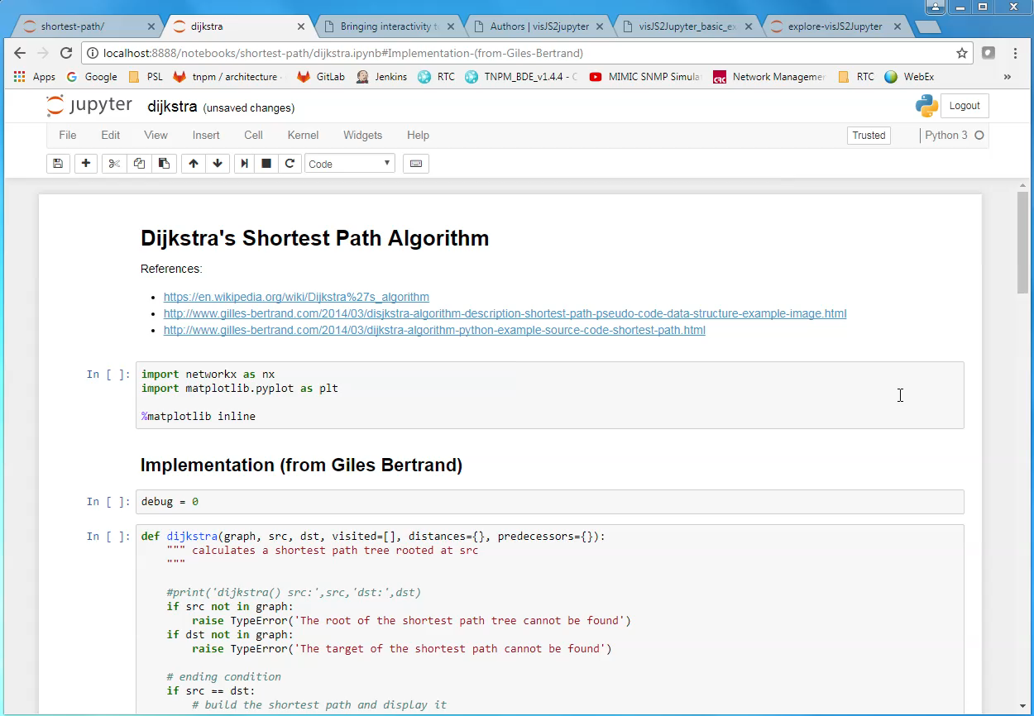
Jupyter Notebook (code)

Slide 25
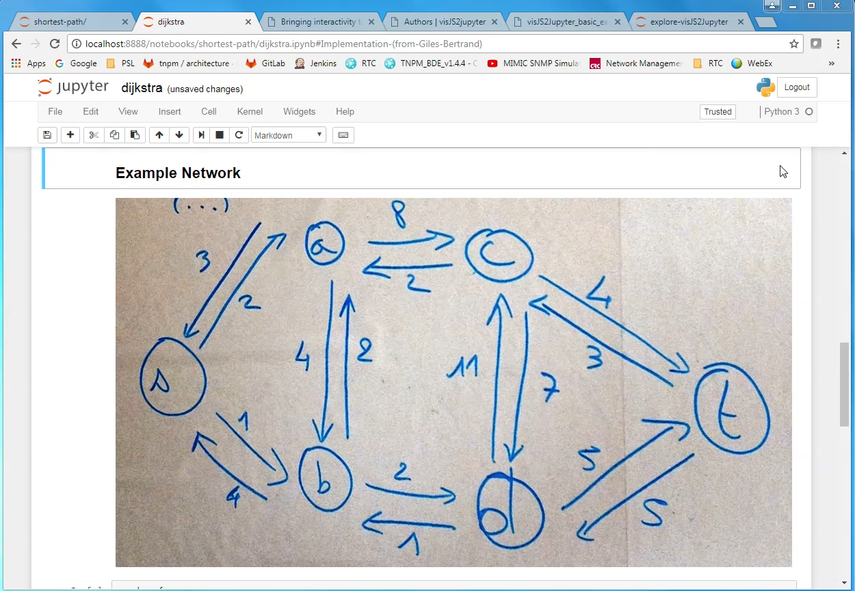
Jupyter Notebook (execution)

Slide 26
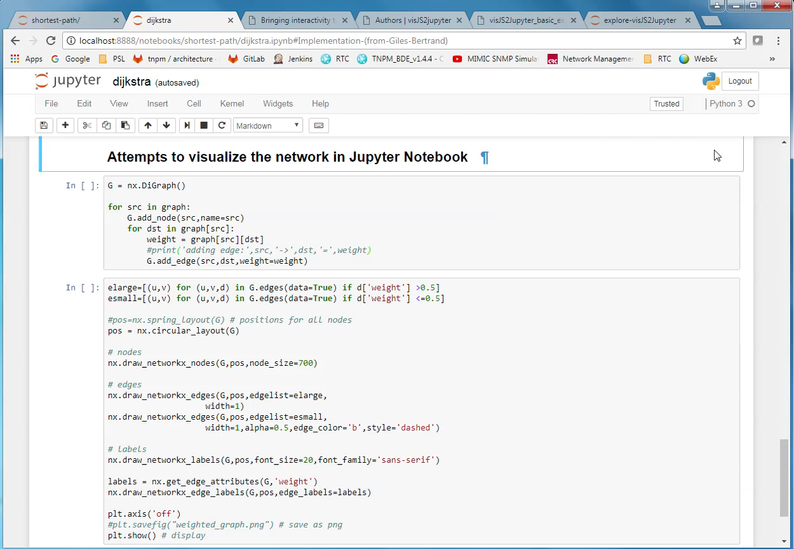
Jupyter Notebook (visualization, try #1)

Slide 27
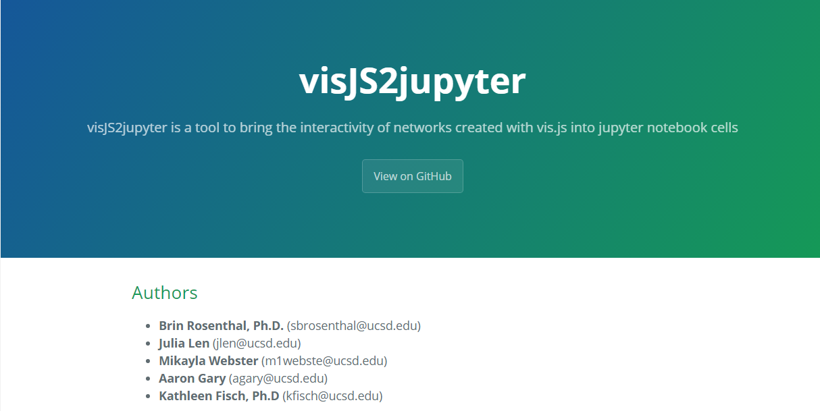
Enter: visJS2jupyter
“a tool to bring the interactivity of networks created with vis.js into jupyter notebook cells”
https://ucsd-ccbb.github.io/visJS2jupyter/
vis.js
A dynamic, browser based visualization library.
Created by a research group at
The Center for Computational Biology & Bioinformatics
Univ. California, San Diego

Slide 28
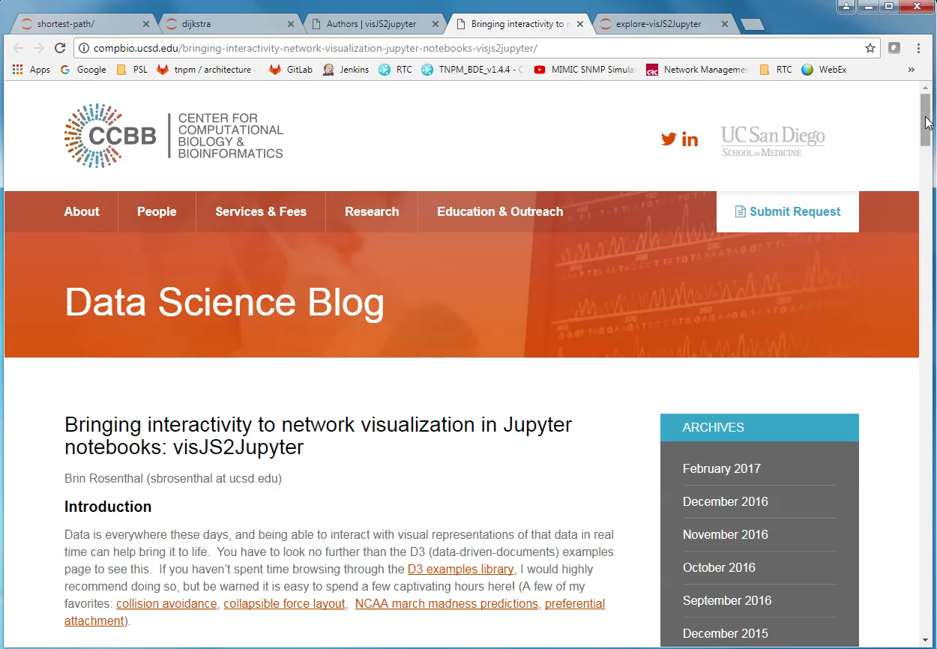
visJS2jupyter (example)

Slide 29
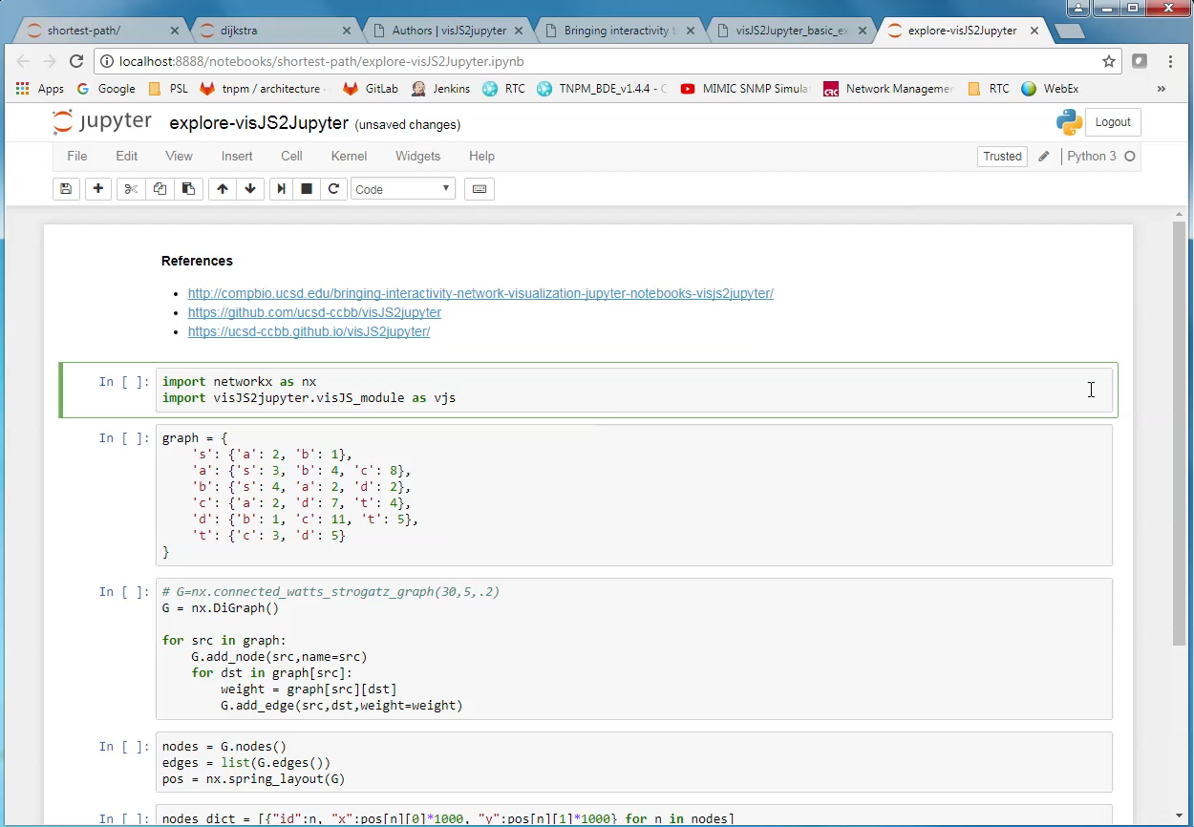
Jupyter Notebook (visualization, try #2)

Slide 30
Exploration – Done!
The Jupyter Notebook exercises helped with
Re-learning Dijkstra’s algorithm
Reading, in depth, some existing code
Stepping through the code with “debug” statements
Exploring some shortest path examples
To reinforce the learning exercises, and solidify understanding
Exploring how to visualize a network
NetworkX + Matplotlib
vis2JSjupyter

Slide 31
Now, on to more interesting things!
Because I wanted to undertake a dev-type project
Because I wanted to work on something where I have a lot of interest

Slide 32
Implementation Objectives
Network described in a file
JSON format
I like the format used in class, so I support that
Choose source and destination nodes
Build it to be extensible, and usable in the future
e.g., in Network Science course (Spring, 2018)

Slide 33
Demo

Slide 38
Lessons Learned
I’m not a web application developer (yet!)
This was my first venture into making any kind of web application
“You don’t know what you don’t know… …until you try something new.”
Jupyter Notebook is awesome!
People are doing all sorts of things with Jupyter
It is not just for summarizing terabytes of data and making bar charts

Slide 39
What’s Next?
Improve the user experience
Additional capability
Make it more resilient

Slide 40
Conclusion
Did D3 make this project easy?
D3 provides a lot of capability “out of the box”
Some things are easy with D3
Some things are not straightforward with D3
There are a lot of D3 resources
d3js.org, bl.ocks.org, Stack Overflow, Twitter, blogs, books, …
The community is generally very welcoming and helpful

